Slide 1
Seesaw PD .
Get Students
Started on Seesaw

Slide 2
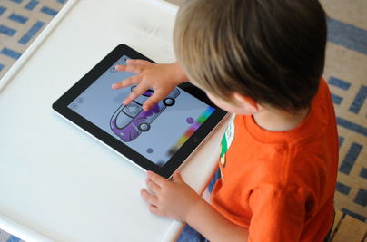

Slide 3
TURN & TALK:
How does technology amplify great teaching?

Slide 4
Digital native (n.)
A person brought up during the age of digital technology and therefore familiar with computers and the Internet from an early age

Slide 5
TURN & TALK:
How do digital natives learn differently?

Slide 6
You may have discussed...
They learn by doing
They have information at their fingertips and know they can find answers for themselves
They ask questions like “why” and “is that the only way to do it?”

Slide 7
Digital natives learn by exploring, collaborating, creating, and approaching problems in new ways.

Slide 8
Objective:
Teachers will receive training and resources to support students to explore how to use Seesaw in ways that foster exploration, collaboration, creativity, and expression.

Slide 9
PART 1:
Teacher vs. Student View

Slide 10
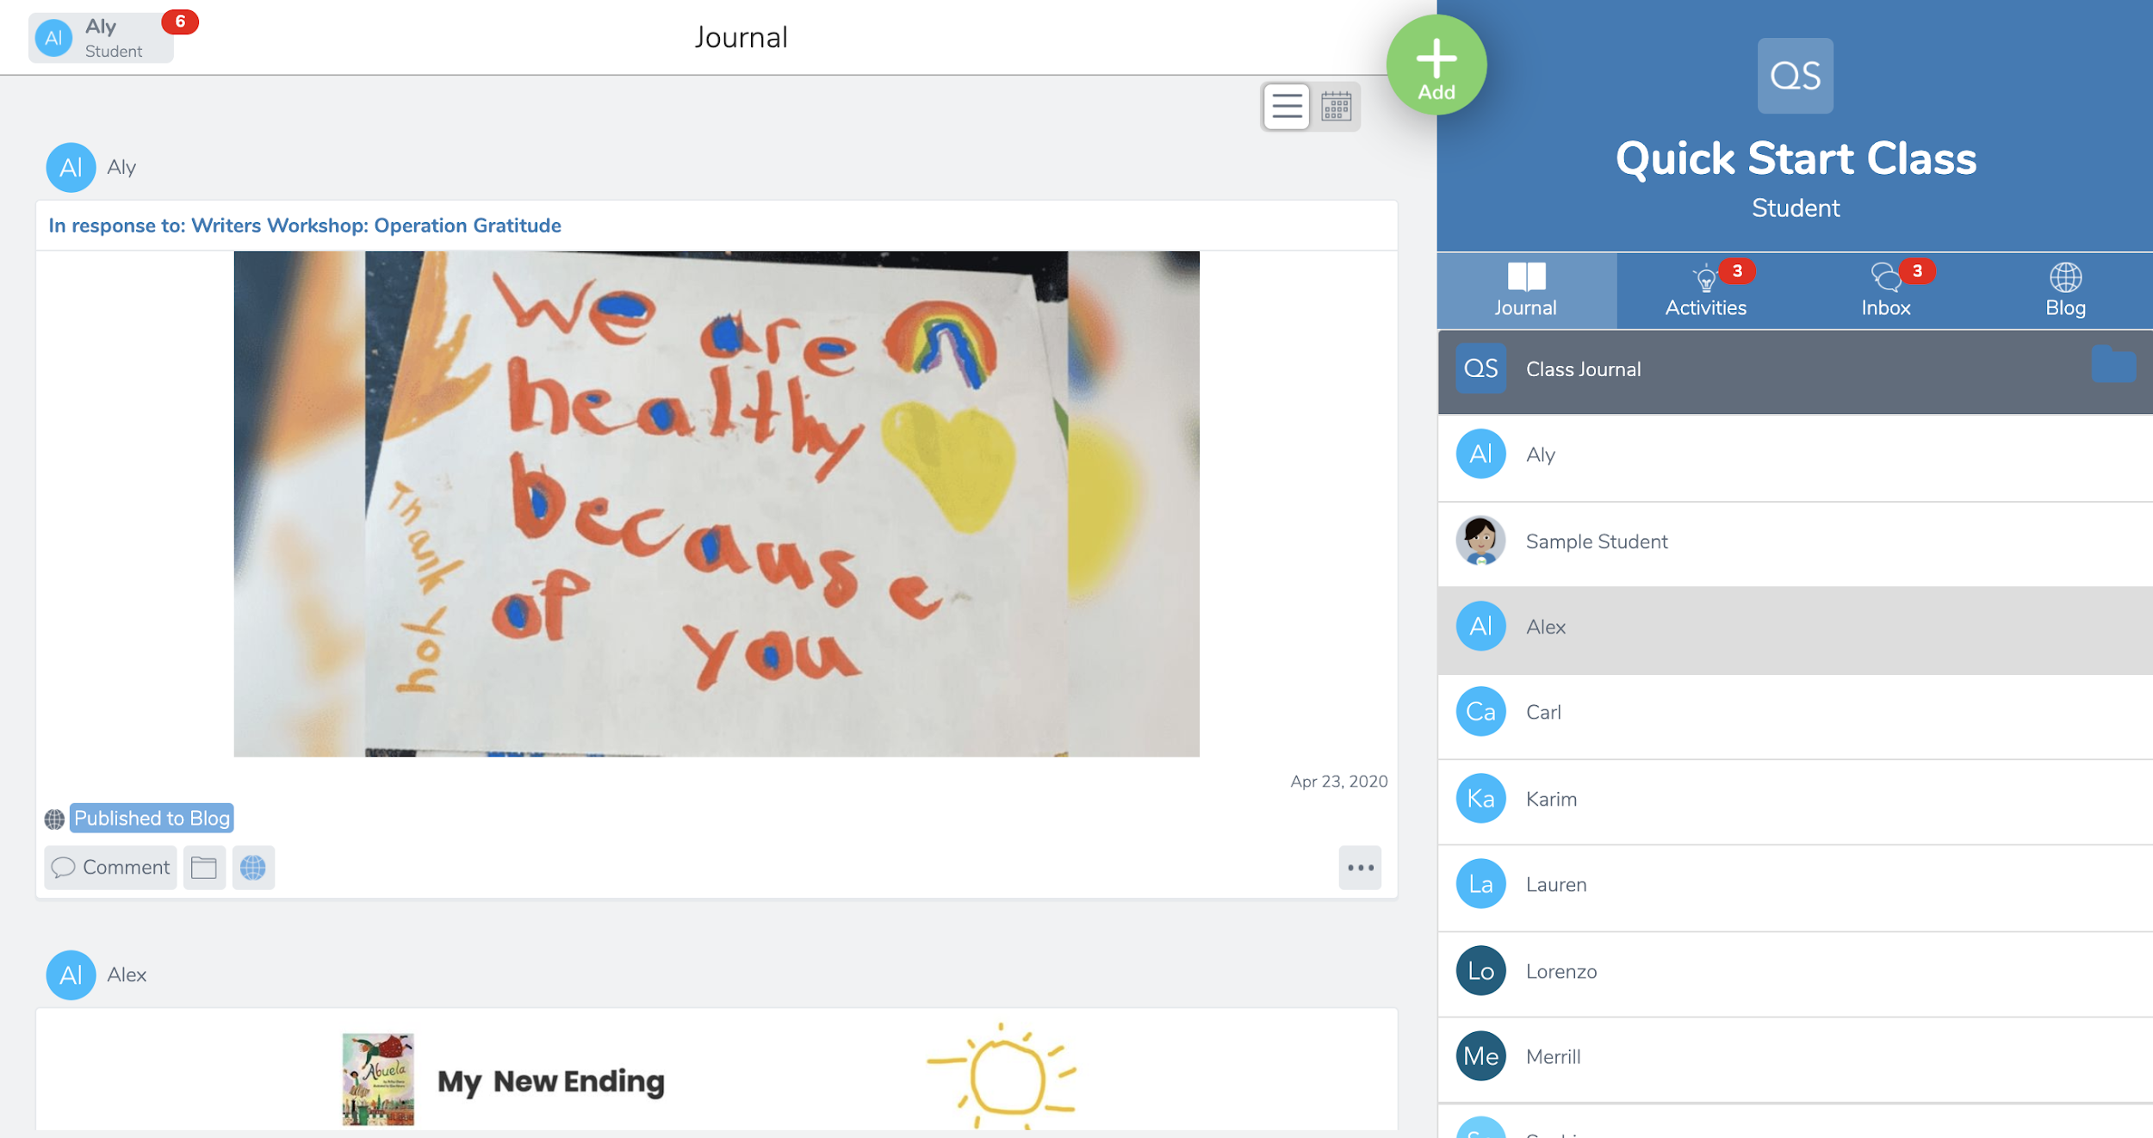
How is the student view different?

Slide 11
You may have noticed...
‘Teacher’ and ‘Student’ under class name
No Skills tab for students
Teachers see more options under posts and when they click the Add button

Slide 12
By default, all students can see all posts to the Class Journal.
Change this in Class Settings

Slide 13
PART 2:
Teach Students How to Use Seesaw

Slide 14
Overview of Lessons...
What is Seesaw video tour
How to Sign In
Create a post
Respond to an activity

Slide 15
Lessons follow an I do/you do format. First you model, then students explore!
Let’s have you experience these lessons as a student.

Slide 16
LESSON 1:
Get Ready to Watch

Slide 18
TURN & TALK:
What excites you most about using Seesaw?
Remember, you’re a student right now!

Slide 19
LESSON 2:
Signing In
Notes:
Only model the sign in method your school will be using.
Email/Google: Slides 20-22
Clever: Slides 23-24
Class Code 1:1 Devices: Slides 25-27
Class Code Shared Devices: Slide 25

Slide 20
Watch Me

Slide 21
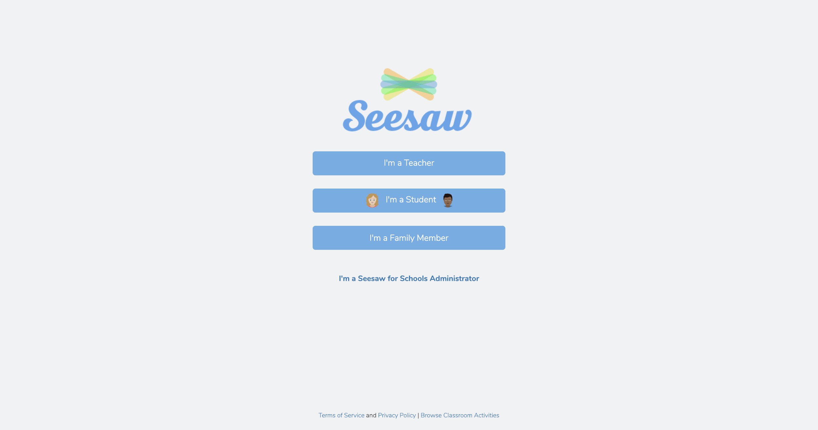
Click I’m A Student
Notes:
All sign in modes

Slide 22
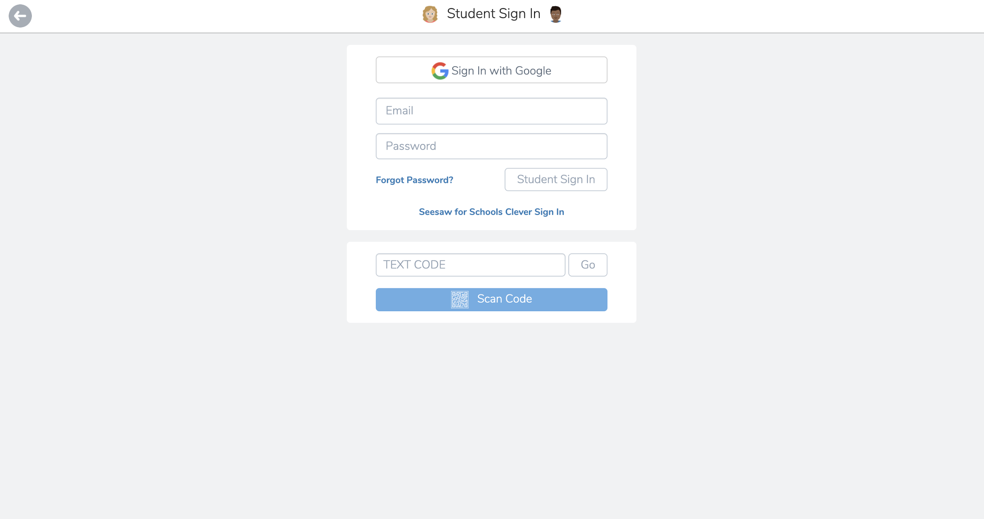
Email/Google Sign In
The first time signing in, enter or scan my class code
Notes:
Email/Google sign in

Slide 23
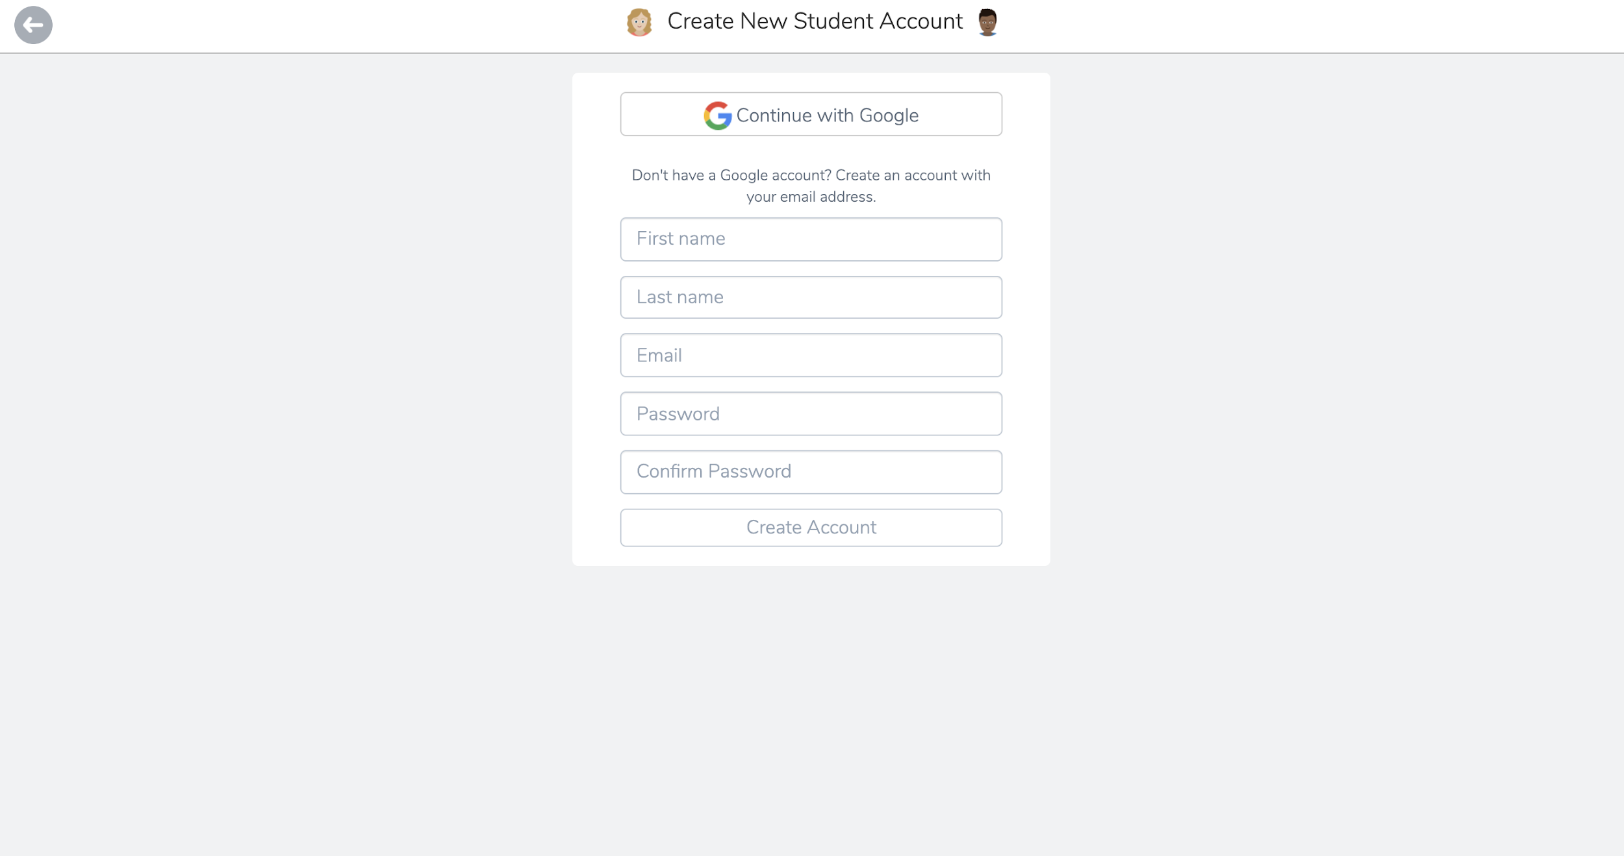
Email/Google Sign In
Use my Google account or my existing email address
Notes:
Email/Google sign in

Slide 24
Email/Google Sign In
After I log in the first time, I can log in normally
Notes:
Email/Google sign in

Slide 25
Clever Sign In
Click Seesaw for Schools Clever Sign In
Notes:
Clever sign in

Slide 26
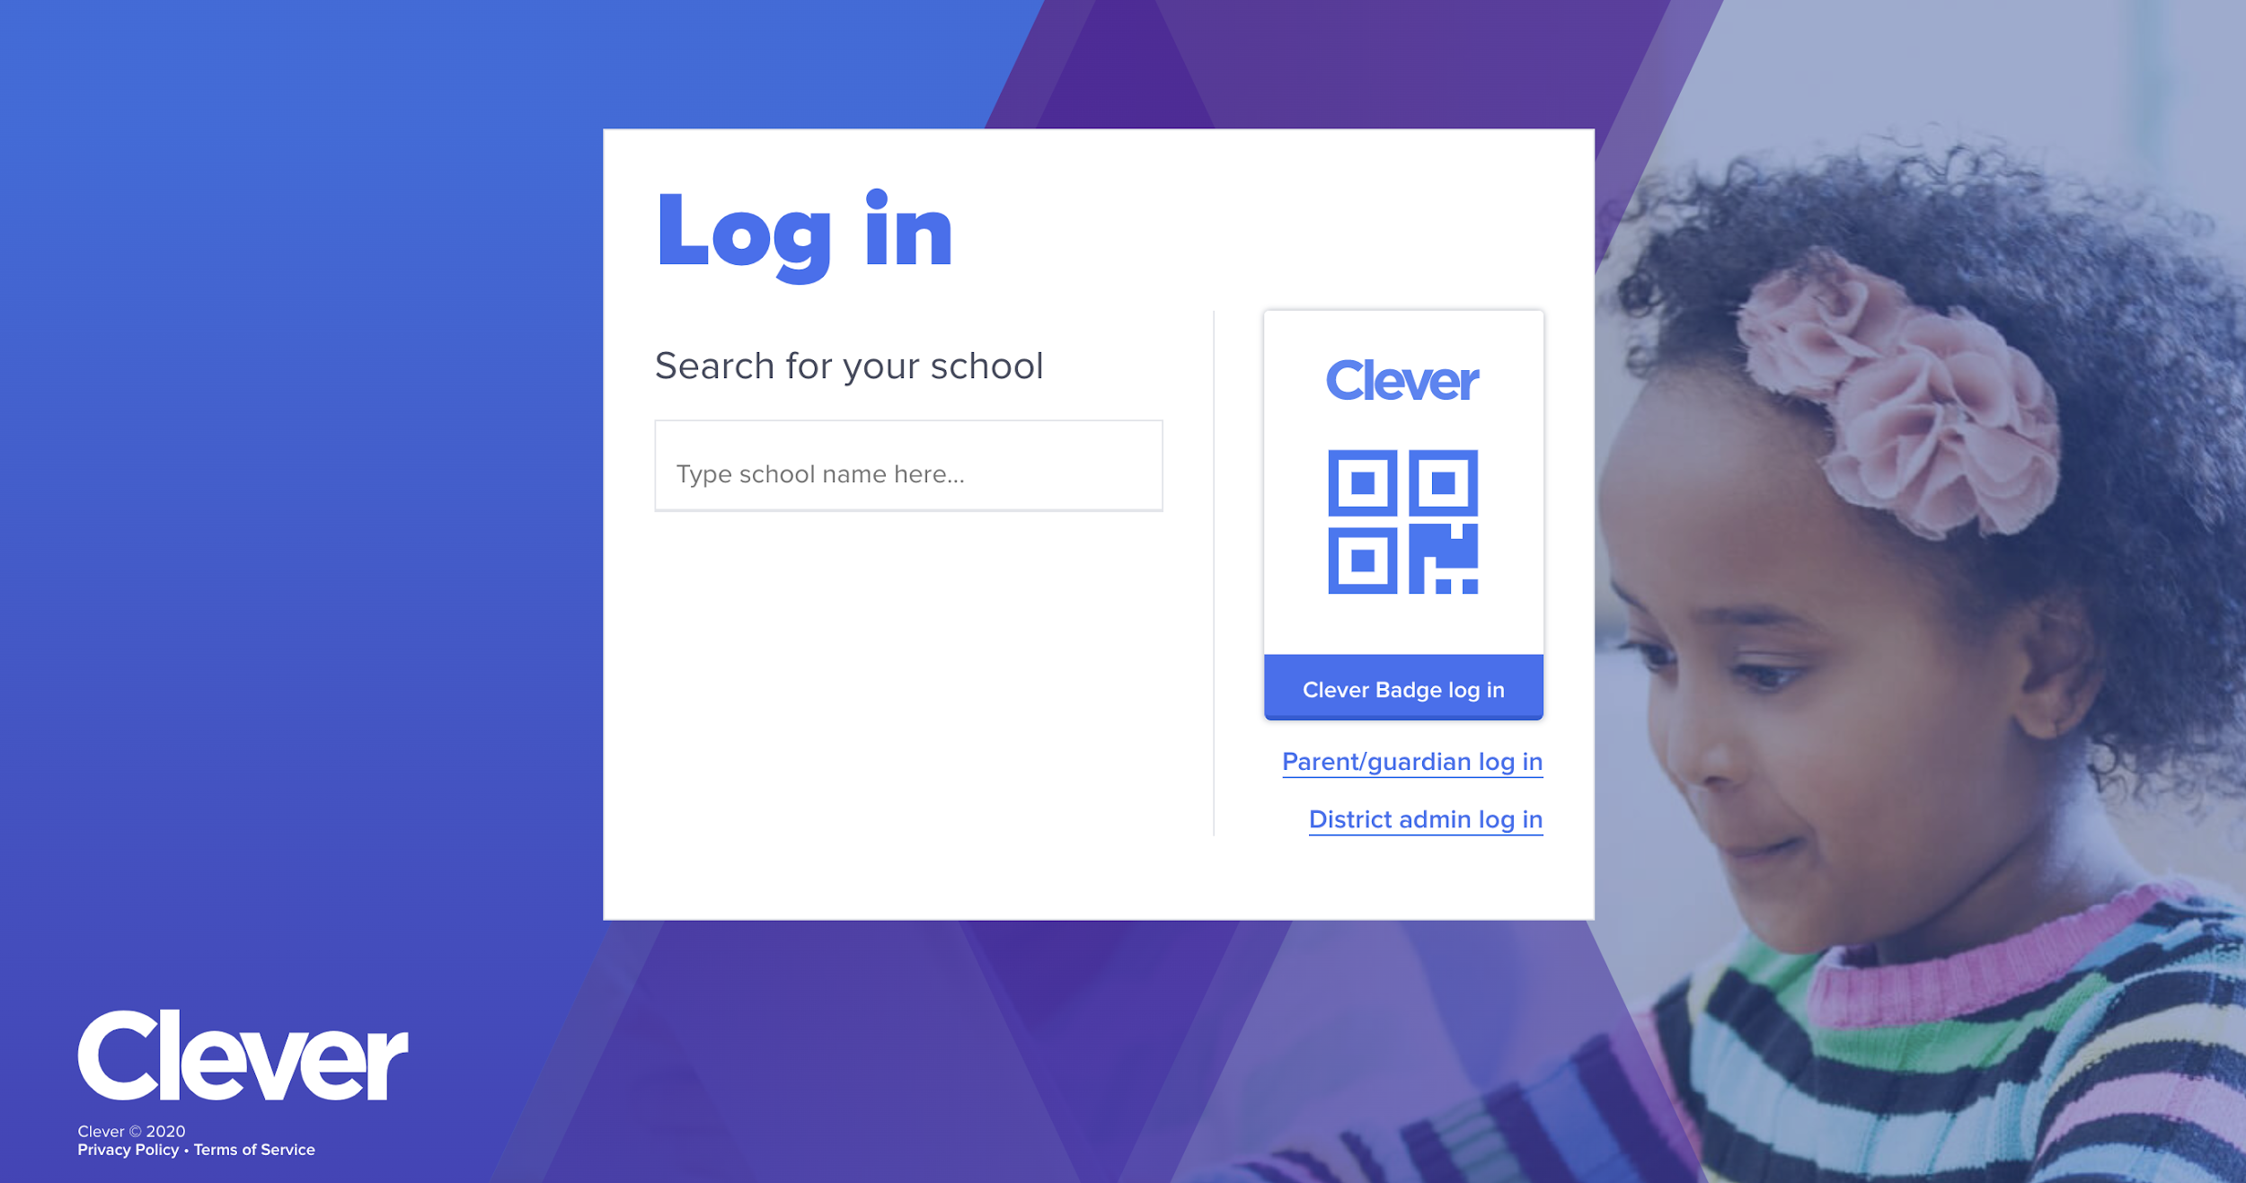
Clever Sign In
Log in, then click back to Seesaw
Notes:
Clever sign in

Slide 27
Class Code / Home Learning Code Sign In
Enter or scan my class code
Notes:
Class code: Shared devices only show this step.
Note: If you have shared devices, your students will choose their names when they post.

Slide 28
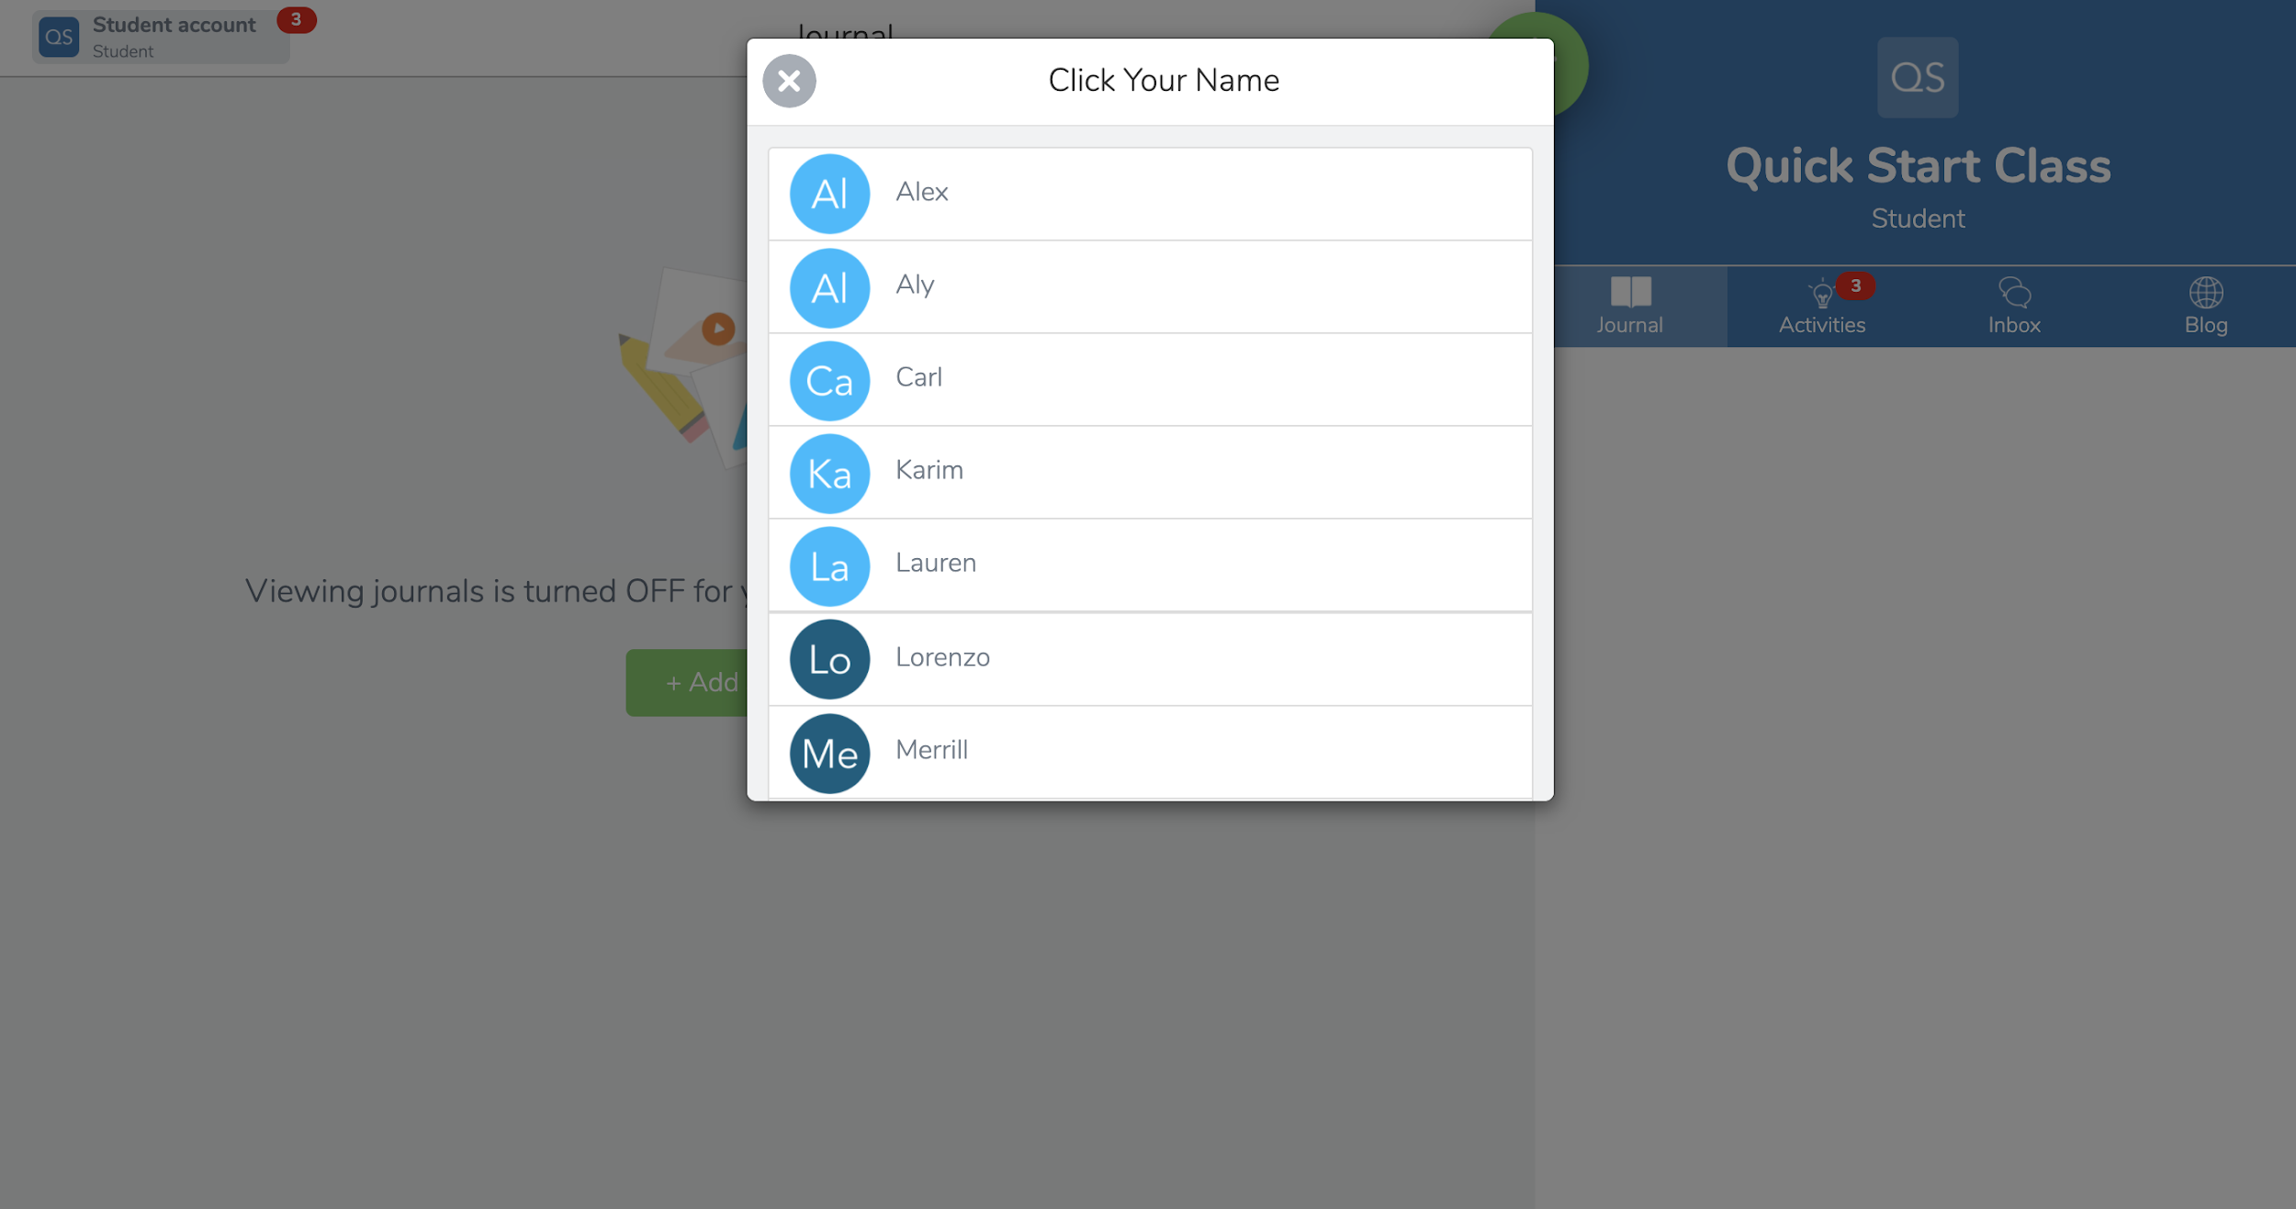
Class Code / Home Learning Code Sign In
Choose my name
Notes:
Class Code 1:1 Devices sign in

Slide 29
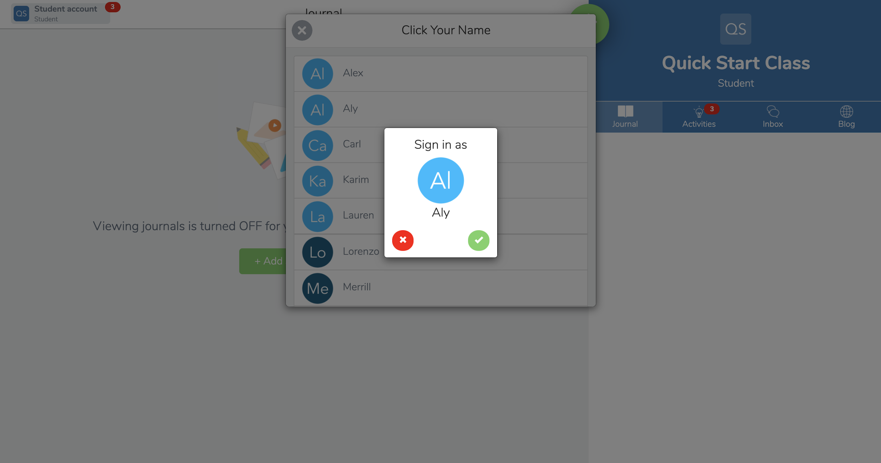
Class Code / Home Learning Code Sign In
Confirm it’s me!
Notes:
Class Code 1:1 Devices sign in

Slide 30
TURN & TALK:
Tell your partner how to sign in.

Slide 31
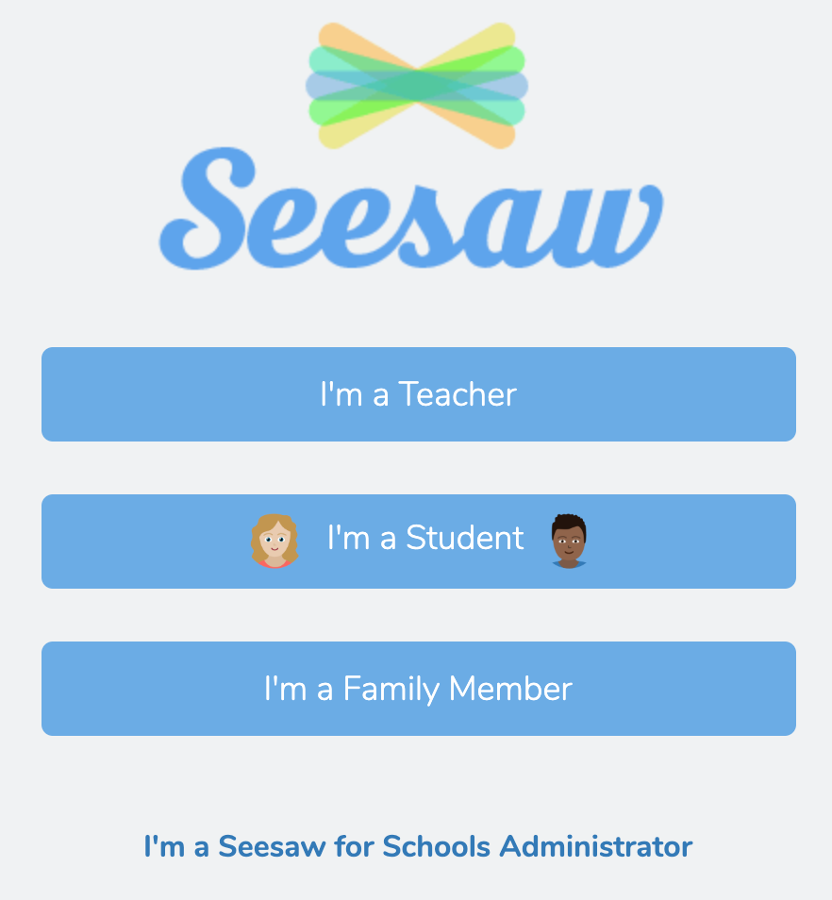
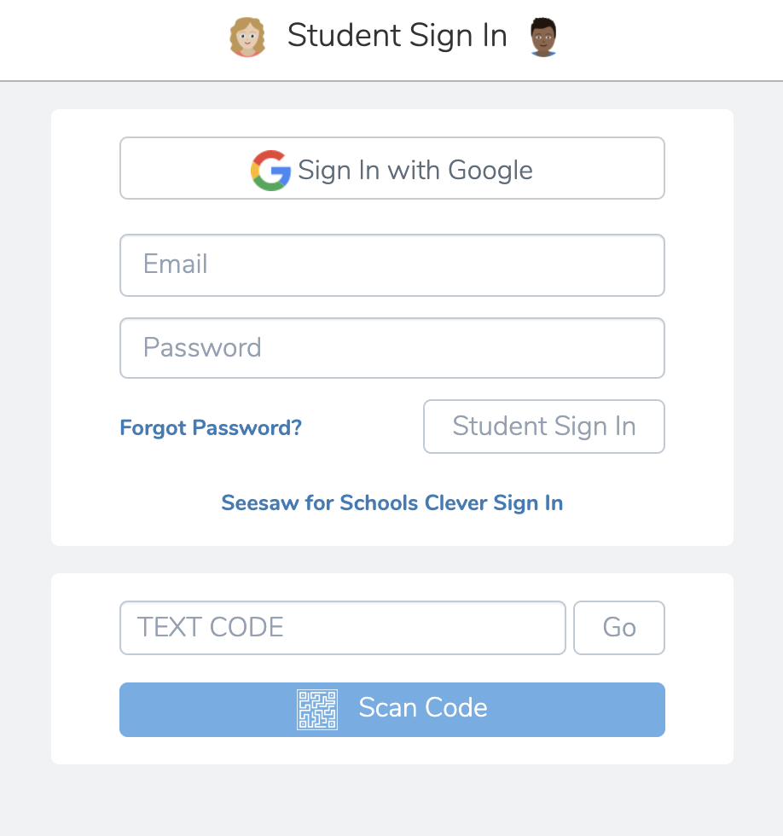
It’s your turn! .
Sign In to Seesaw
We’ll skip the ‘you do’ for this part!

Slide 32
LESSON 3:
Create a Post
Notes:
Modify the activity based on age:
Slide 34 for PreK-2 teachers
Slide 35-36 for 3+ teachers

Slide 33
Watch Me

Slide 34
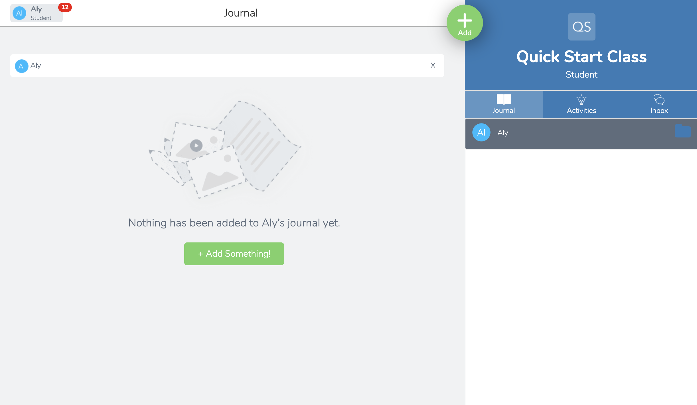
Click the green Add button

Slide 35
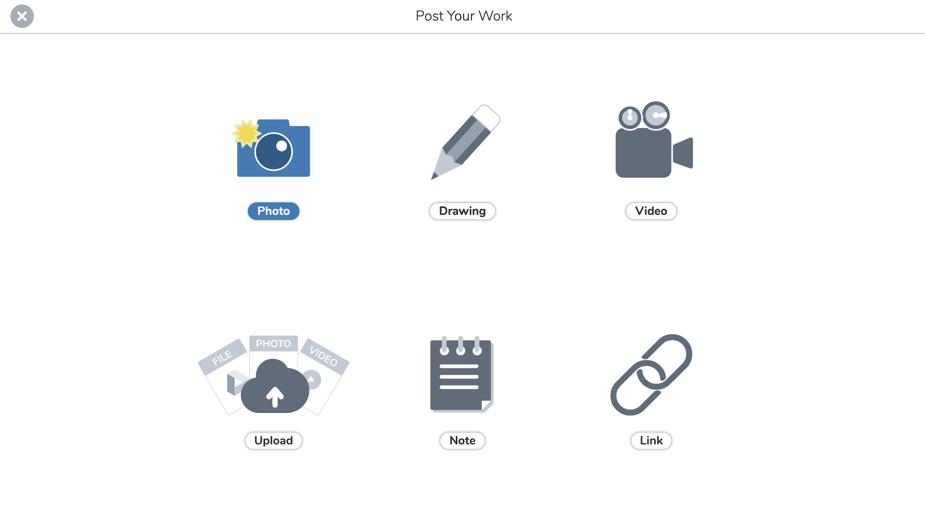
Choose Photo and take a selfie

Slide 36
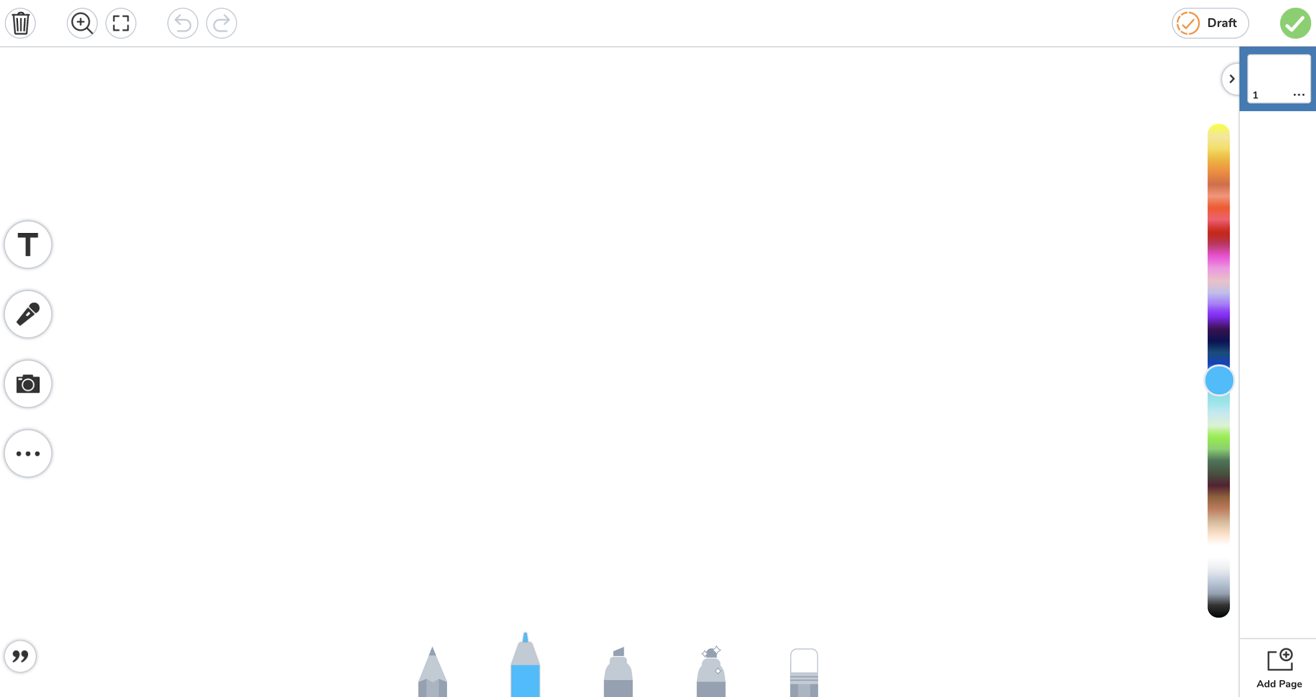
PreK-2: Click the mic to tell something special about you!

Slide 37
Grades 3+: Use Pens and Labels to add words that describe you!

Slide 38
Click the green Check when you’re done

Slide 39
TURN & TALK:
Tell your partner what you will create for your first post.

Slide 40
It’s your turn! .
Create Your First Post
→
→
→
OR
Since you’re a teacher, click Post Student Work

Slide 41
LESSON 3:
Respond to an Activity

Slide 42
Watch Me

Slide 43
Click the Activities tab

Slide 44
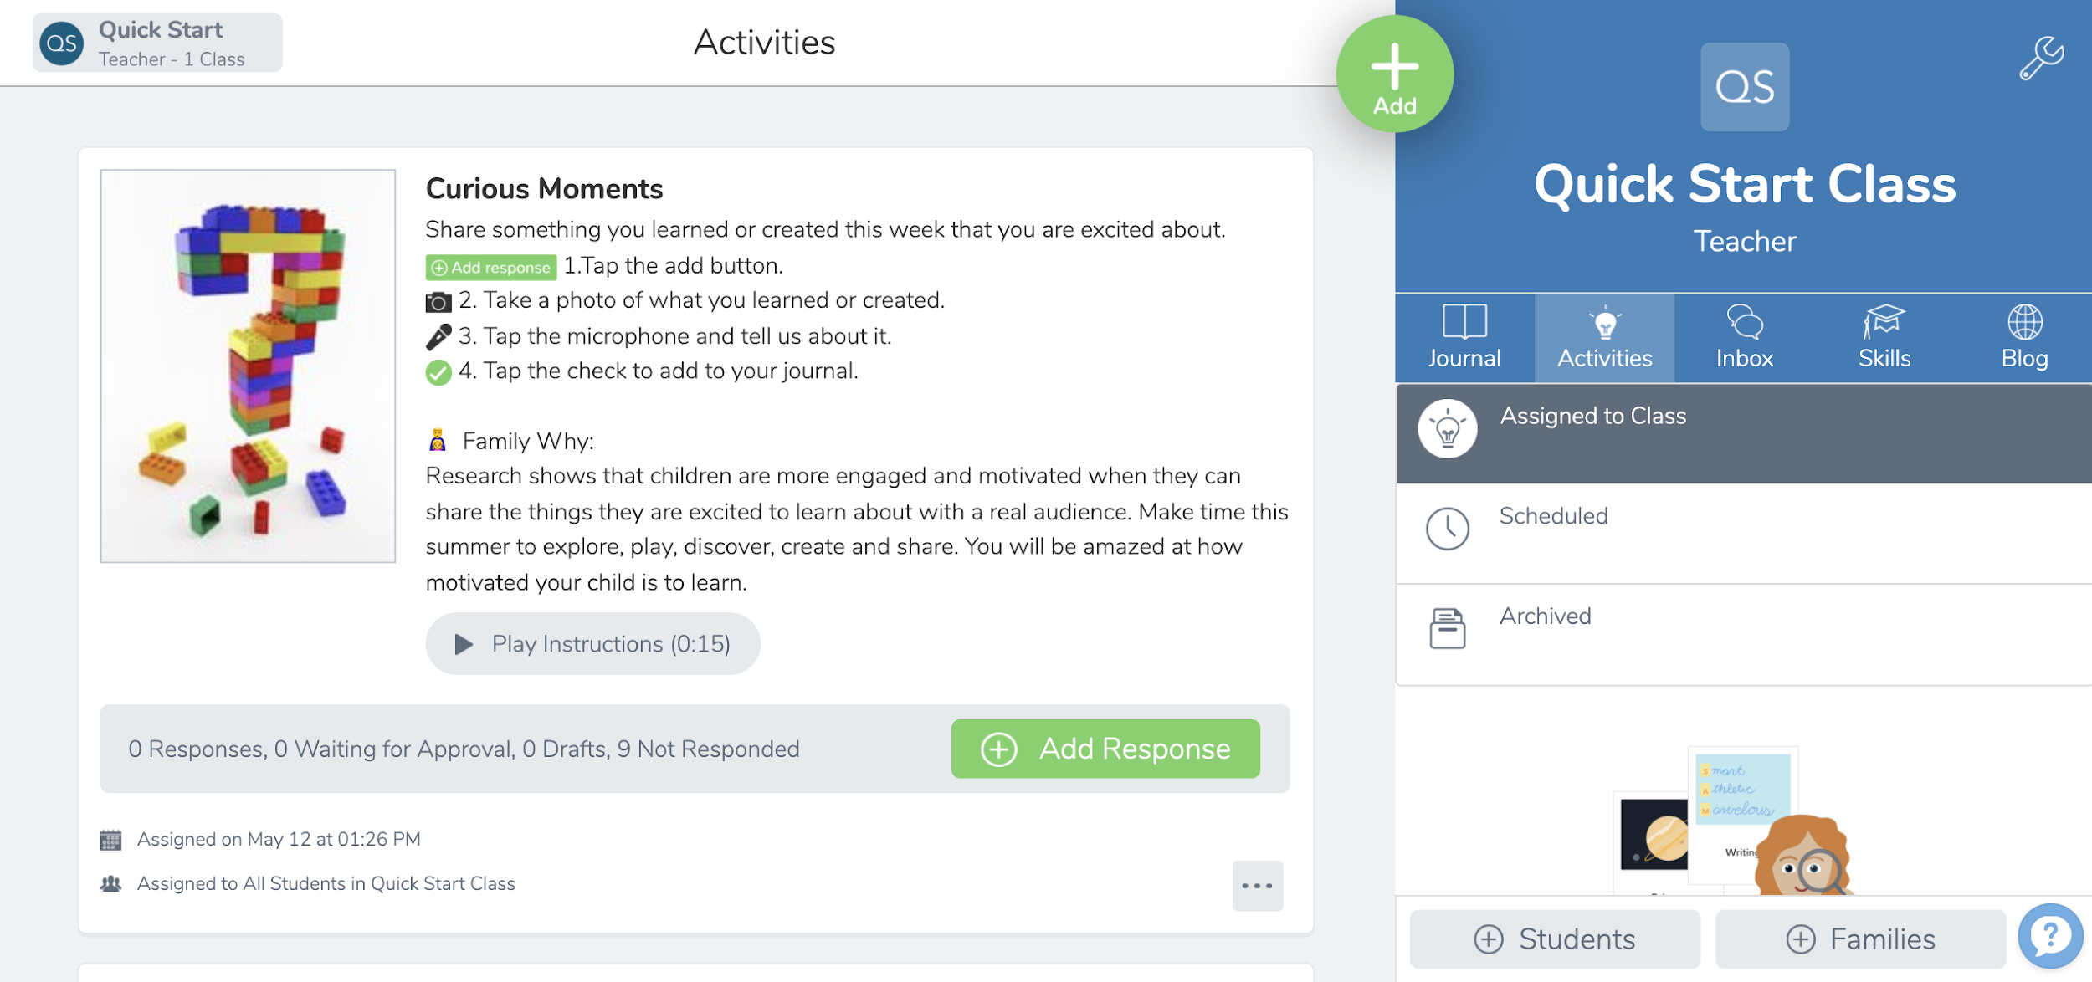
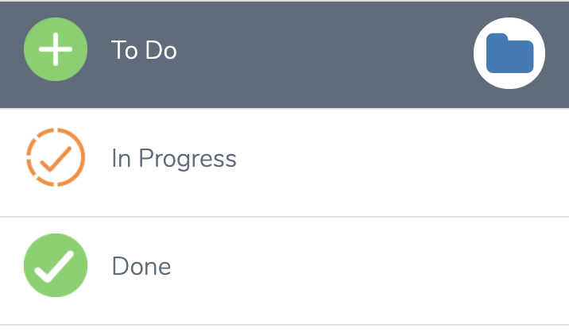
Click Add Response

Slide 45
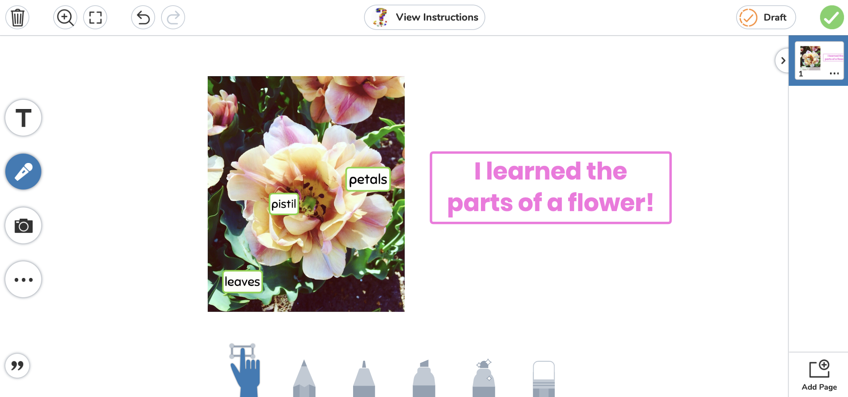
Take or draw a picture of what you learned

Slide 46
Tell about what you learned by clicking the mic

Slide 47
Click the green Check when you’re done

Slide 48
TURN & TALK:
Tell your partner the button you click to respond to an activity.

Slide 49
It’s your turn! .
Respond to an Activity
We’ll skip the ‘you do’ for this part!
→
→

Slide 50
PART 3:
Planning

Slide 51
THINK TO YOURSELF:
Where will your students need support? What modifications can you make to these lessons to support your students?

Slide 52
Let’s Discuss .
What modifications do you plan to make?

Slide 53
You may have discussed...
Chunk the lessons into smaller/larger pieces
Choose a different activity
Model in small groups rather than whole class
Have students work in pairs

Slide 54
Get all resources at .
web.seesaw.me/get-students-started-kit

Slide 55
EXIT TICKET:
Your plan for implementation

Slide 56
You did it!
You learned...
✓ Differences for teachers and students
✓ 4 lessons to introduce Seesaw
✓ Ways to modify lessons for your students

Slide 57
Find more free trainings at .
web.seesaw.me/training

